Slide 1
High Performance Computing
Lecture 12: Case Study: Stencil Computation in MPI
Beakal Gizachew Assefa
1

Slide 2
Hiding Communication Overhead
Non-­‐blocking communication calls can be used to hide communication overhead
o Also called hiding communication latency
When used correctly, these primitives are capable of overlapping communication overheads with useful computations.
What is the maximum speedup you can get by hiding communication overhead?
2

Slide 3

























Split-­‐Phased Execution
Phase 1: initiate communication with Irecv(), Isend()
Phase 2: synchronize Wait()
Perform unrelated computations between the two phases
Each pending Irecv() and Isend() must have a distinct buﬀer
OVERLAP NO OVERLAP
Irecv(x,req) Send(..) Compute(y) Wait(req) Compute(x)
Irecv(x) Send(…) Wait(x) Compute(X) Compute(y)
3

Slide 4





























Nearest neighbor exchange in a ring topology with Non-­‐Blocking Messages
#include "mpi.h" #include <stdio.h>
main(int argc, char *argv[]) {
int numtasks, rank, next, prev, buf[2], tag1=1, tag2=2;
MPI_Request reqs[4]; MPI_Status stats[4];
MPI_Init(&argc,&argv); MPI_Comm_size(MPI_COMM_WORLD, &numtasks); MPI_Comm_rank(MPI_COMM_WORLD, &rank);
prev = rank-1; next = rank+1; if (rank == 0)
prev = numtasks - 1;
if (rank == (numtasks - 1)) next = 0;
MPI_Irecv(&buf[0], 1, MPI_INT, prev, tag1, MPI_COMM_WORLD, &reqs[0]); MPI_Irecv(&buf[1], 1, MPI_INT, next, tag2, MPI_COMM_WORLD, &reqs[1]);
MPI_Isend(&rank, 1, MPI_INT, prev, tag2, MPI_COMM_WORLD, &reqs[2]); MPI_Isend(&rank, 1, MPI_INT, next, tag1, MPI_COMM_WORLD, &reqs[3]);
{ do some work }
MPI_Waitall(4, reqs, stats);
Do some useful work to hide the communication overhead. Work cannot depend on the message buﬀers (e.g. rank and buf)
MPI_Finalize();
}
4

Slide 5
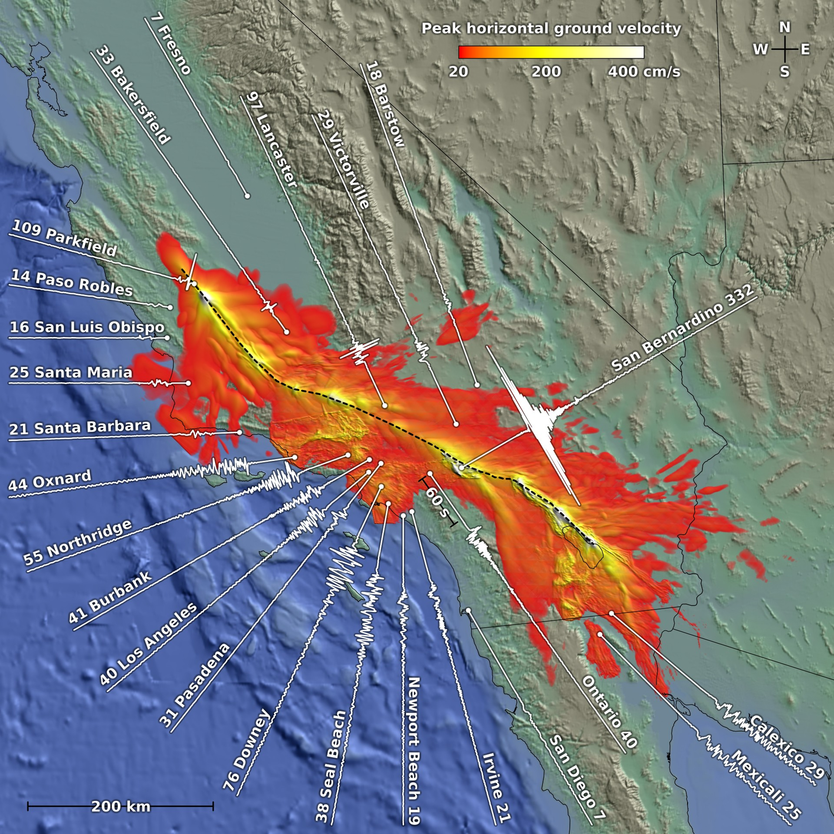
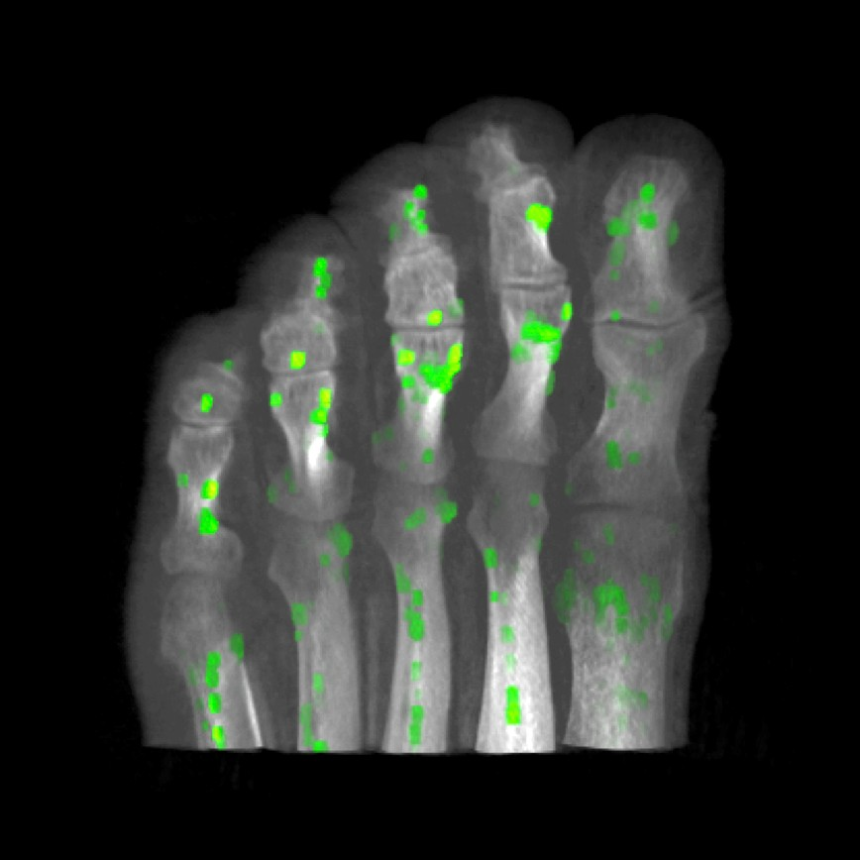
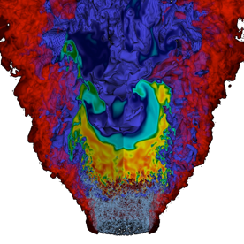
Stencil Computation
Stencils are the basis for many algorithms to numerically solve partial diﬀerential equations (PDEs)
⦿ Approximate derivatives numerically
⦿ Countless examples in scientific and engineering problems
⦿ Turbulence ﬂow, seismic wave propagation, ocean currents, water ﬂow in a pipe, blood ﬂow, weather forecast, air ﬂow around a wing
⦿ Multimedia applications (e.g. image smoothing)
⦿ Uses finite diﬀerence or finite volume method
Earthquake Simulation Source: Yifeng Cui (SDSC)
Image Corner Detection Source: Han Suk Kim (Apple)
Combustion Turbulence Flow Source: John Bell (LBNL)
5

Slide 6
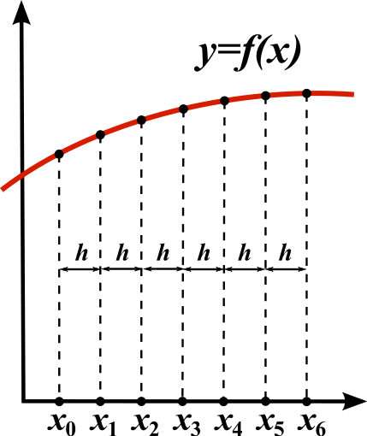
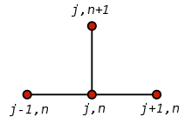
Stencil Computation
Discretizes the problem domain
Divides the domain in space into a uniform grid (structured grid) x₀, x₁ …x_{n} and in time t₀, …t_{N}
Produces sets of discrete numerical approximations to the derivative in an iterative manner (time-­‐stepping)
Performs nearest neighbors update
The stencil for the most common explicit method for the heat equation.
Src: Wikipedia
6

Slide 7
















































Stencil Shape
Stencil shape can be diﬀerent depending on the numerical algorithm used
Here 5-­‐point in 2D, 13-­‐point and 7-­‐point in 3D are shown
o Next value of green point depends on the current value in the nearest neighbors
//image smoothing example using 5-point stencil for iter = 1 : nSmooth
for (i,j) in (0:N-1, 0:N-1)
Imgnew [i,j] = (Img[i-1,j]+Img[i+1,j]+Img[i,j-1]+Img[i, j+1])/4
Swap(Imgnew,Img)
7

Slide 8








Cell Update
Since we are updating the next value of a cell from its neighbors, typically we need to keep two grids around
o Current and Next Grid
They are techniques to implement with one grid, they are called update-­‐ in-­‐place methods
Grid(t)
Grid(t+1)

Slide 9












Parallel Implementation
Partition the structured grid, assigning each partition to a unique process
Diﬀerent partitioning methods according to the processor geometry
1 X 4
4 X 1
2 X 2

Slide 10








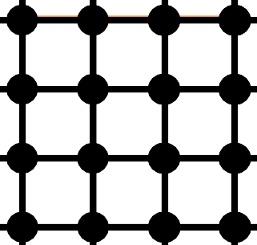
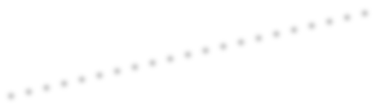












Data Dependences
Each process has its own data partition
Do we need any data points from neighboring processes?
o Yes, how did we do it in Game of Life?
P0 P1
P2
P3
P4 P5
P6
P7
P8 P9
P10
P11
P12 P13 P14
P15

Slide 11











Data Dependences
In order to update red, we need green points (local) and blue points from other processes (remote)
Too expensive to communication individual array values one at a time
“Ghost” cells hold a copies oﬀ-­‐process values
P0 P1
P2
P3
P4 P5
P6
P7
P8 P9
P10
P11
P12 P13 P14
P15

Slide 12






Ghost Cells (Halos)
Ghost cells are allocated for the information needed from other processes
Thus each processor allocates (N+ 2*ghosts) ^{d} space to accommodate ghost region
Depth of ghost region depends on the numerical method used
Ghost cells
Ghost cells

Slide 13



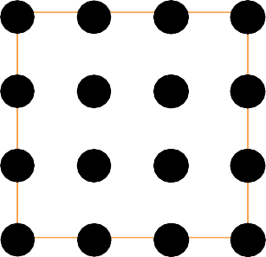
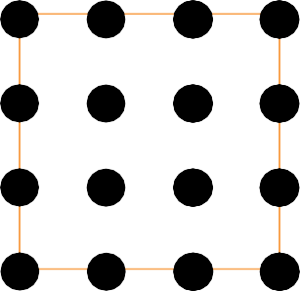


Ghost Cell Exchange-­‐ Receive
Need to update ghosts every iteration so that a process has the latest values
This is done with message exchange between processes
Receive
P_{i}
^{P}i+1

Slide 14







Ghost Cell Exchange-­‐ Send
Need to update ghosts every iteration so that a process has the latest values
This is done with message exchange between processes
o Note that the elements are not contiguous in memory – need to pack a message at the source and unpack at the destination
Send
P_{i}
^{P}i+1

Slide 15














Msg Exchange with All Neighbors
How many processors involved in communication depends on the numerical algorithm and domain decomposition
o In 2D, typically sends/receives involve 4 neighbors (N, S, W, E)
How many neighbors are there for 3D problems?
Receive from north
Ghost cells
Receive from West
Receive from East
If the computation uses the corner cells in the update, then need to exchange ghosts with 4 more processes: NE, NW, SE and SW
Receive from south
15

Slide 16

















Ghost Cell Exchange
What happens to processors that are at the edge of the physical domain of the problem?
o For example, no north and west neighbors for P0
P0 | P1 | P2 | P3 •
P4 | P5 | P6 | P7
P8 | P9 | P10 | P11
P12 | P13 | P14 | P15
Depends again on the numerical algorithms’ boundary condition
If it is periodic, then P0’s west neighbor is P3
Or it may mirror itself
Or it may be set to a constant value (zero).
Or it may use a function to calculate its value

Slide 17
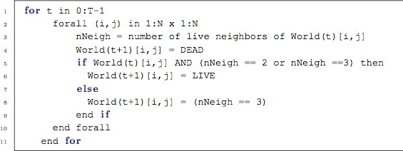
Game of Life
Game of Life in fact uses stencil computation
Next world’s data depends on the current world’s values – that’s why we used two grids
How come we didn’t worry about ghost cell exchange in Game of Life?
– Is our implementation wrong?

Slide 18















Communication Cost for 1D Geometries
Assumptions P processors divides input size N evenly
1 word = double precision ﬂoating point = 8 bytes
For horizontal strips, data are contiguous
Row-­‐major C arrays
Message Size = 16N bytes (sent to North + sent to South) per processor
Time(comm) = 2(α+8N/β) per processor
α :latency
β: bandwidth
N

Slide 19








Communication Cost for 1D Geometries
For horizontal strips, data are contiguous
o Row-­‐major C arrays
For vertical strips, data are not contiguous in memory
This model doesn’t take into account the message packing overhead
Ideal for Row-­‐major C arrays
Ideal for Column-­‐major Fortran arrays

Slide 20









Communication Cost for 2D Geometries
Assumptions
√P divides N evenly
1 word = double precision ﬂoating pt. = 8 bytes
Ignore the cost of packing message buﬀers
Message size sent in bytes for one neighbor is 4*8N/√P
Time(comm) = 4(α+8N/(β√P) )
N/√P

Slide 21
Process Geometry
Block decomposition is harder to implement than strip decomposition
Any good reasons why an application should support block decomposition?
Strip decomposition will outperform block decomposition resulting in lower communication times
when 2(α+8N/β) < 4(α+8N/(β√P ))
Optimal process geometry depends on the N, β and α.

Slide 22

The Aliev-­‐Panfilov Method
Models signal propagation in cardiac tissue
Can be used in clinical diagnosis and treatment of diseases
Reaction-­‐diﬀusion system
Reactions are the cellular exchanges of certain ions across the cell membrane during the cellular electrical impulse
Aliev-­‐Panfilov has two state variables
Transmembrane potential: E
Recovery of the tissue: R
Reference:
R. Aliev and A. V. Panﬁlov. A Simple two-­‐variable model of cardiac excitation. Chaos, Solions & Fractals, 7(3): 293-­‐301, 1996.
M. Hanslien. Stability of Two Time-­‐integration for the Aliev-­‐Panﬁlov System. International Journal of Numerical Analysis and Modeling, 427-­‐442, 2011

Slide 23
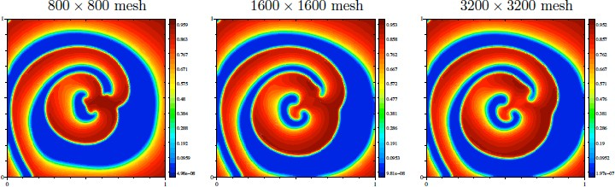
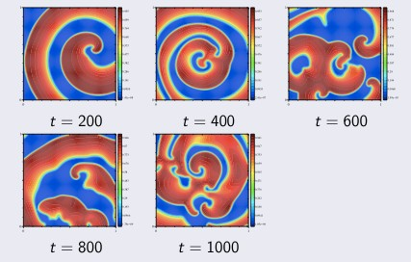
Aliev-­‐Panfilov
Models signal propagation in cardiac tissue
o Demonstrates complex behavior of spiral waves that are known to cause life-­‐threatening situations
Simulation Results at Diﬀerent resolution (grid size)
Simulation at diﬀerent timesteps
Img. Source: Xing Cai (Simula)
23

Slide 24
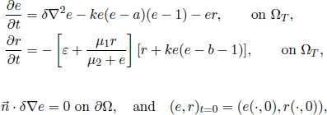
Numerical Method
The model comprises two parts:
2 Ordinary Diﬀerential Equations (ODE)
Describes the kinetics of reactions occurring at every point in space.
Partial Diﬀerential Equation (PDE)
Describes the spatial diﬀusion of reactants
Assignment implements the first-­‐order explicit numerical scheme to solve the model

Slide 25
ODE and PDE Solvers
ODE solver:
No data dependency, trivially parallelizable
Requires a lot of registers to hold temporary variables
CPU intensive
PDE solver:
Jacobi update for the 5-­‐point Laplacian operator.
Sweeps over a uniformly spaced mesh
Updates the voltage according to weighted contributions from the four nearest neighboring positions in space
PDE part:
E^{t}[i,j] = E^{t-1}[i,j] + α(E^{t-1}[i+1,j] + E^{t-1}[i-1,j] + E^{t-1}[i,j+1] + E^{t-1}[i,j-1] - 4E^{t-1}[i,j])

Slide 26
Assignment #3
MPI + OpenMP parallelization of the Aliev-­‐Panfilov method
Serial code is provided
Uses N+2 grid size to accommodate ghost cells
Three grids: Eprev, E, and R
Start MPI with 1D geometry (row partitioning)
Next add 2D geometry
Finally add OpenMP parallelism
You can use blocking or non-­‐blocking calls
We are not asking you to implement communication hiding version
Warning: Will take more eﬀort to implement the communication hiding version-­‐ no extra credit
Serial code reports the Gﬂops rates and sustained bandwidth rates (in addition to time in sec)
Why are Gﬂops and memory bandwidth rates useful?
We ask you to measure the time spent in communication.
How can you measure that?

Slide 27
Pseudo Code for Parallelization
Broadcast the input arguments
Create buffers for send and receive messages
While (t < T)
Post Ireceive for all neighbors Send data to neighbors
Wait for completion Unpack the message
Perform the PDE and ODE solvers
If (plot at t is true and rank is 0) Gather data from all processes Plot the mesh

Slide 28










A side note on Corner Cells
Receive from north
Instead of exchanging messages with corner processes, experimental studies showed that it is better to receive messages from N, S, W, E in two steps
Receive from West
Receive from East
Because corner points are also sent to our neighbors
For example, NW corner point has to be sent to our N and W neighbors. We can receive that data from them instead of our NW neighbor
Network topologies and message exchange implementations are more optimized for immediate neighbor communication
Receive from south

Slide 29
Acknowledgments
These slides are inspired and partly adapted from
Mary Hall (Univ. of Utah)
Scott Baden (UCSD)
The course book (Pacheco)
o https://computing.llnl.gov/tutorials/mpi/

